Slide 1
SMART ATTENDANCE
By
A.Sai praneeth(10mse0066)
g.DINESH CHOWDARY(10MSE0018)

Slide 2
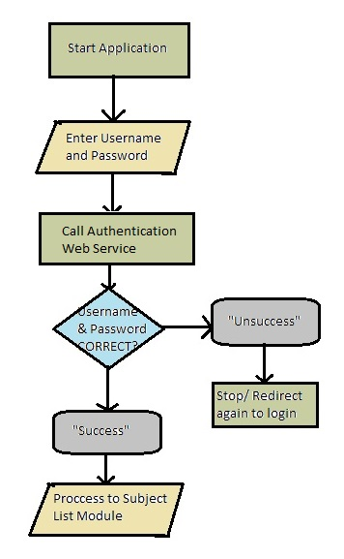
1.0 Detailed Design
1.1 Module Design:
1.1.1 User Authentication Module:
Requires Username and Password.
When Requested , calls web service.
If Response = “SUCCESS” then Calls subjects list.
Else Remains on same Page.

Slide 3
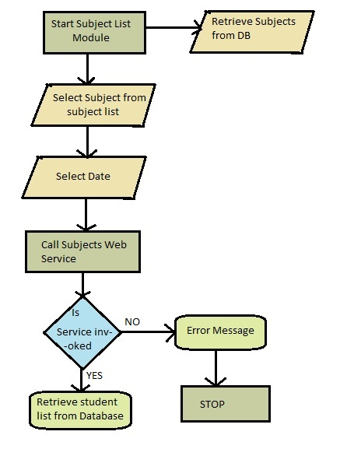
Contd..
1.1.2 Subject List Retrieval Module :
Requires Username .
Calls a PHP Script and retrieves all subjects in database.
Returns data in Json format.
Json format is Parsed in Android .

Slide 4
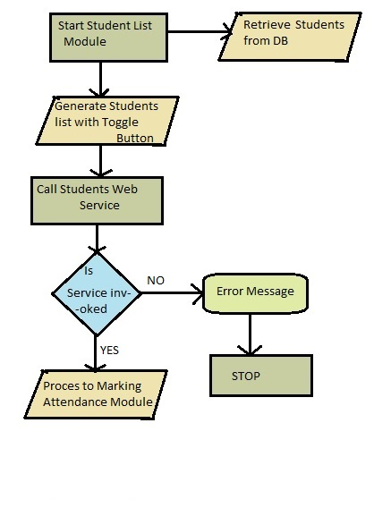
Contd..
1.1.3 Student List Retrieval Module
Requires Faculty name (username) and Selected Subject.
Request PHP Script and retrieve students in Database.
Returns Data in Json Format.
Json format is Parsed in Android.

Slide 5
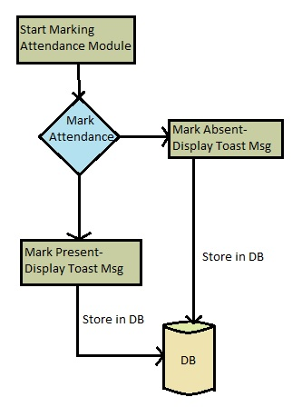
Contd..
1.1.4 Marking Attendance Module:
Displays each student name along with a Toggle button.
Faculty marks attendance.
Stores all details in Database.

Slide 6
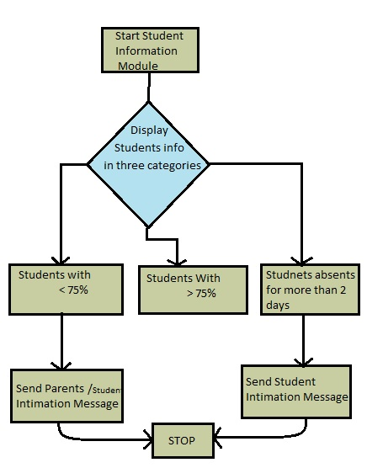
Contd..
1.1.5 Display Student Information & Message Intimation Module :
Displays all Students information in three Categories ..
Students >= 75% Attendance.
Students < 75% Attendance.
Students absent for more than 2 classes.
Sends Intimation message to parents and Students.

Slide 7
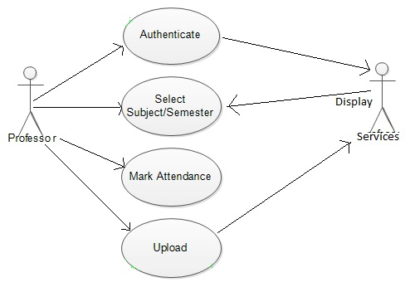
2.0 Design
2.1 Use Case Diagram:

Slide 8
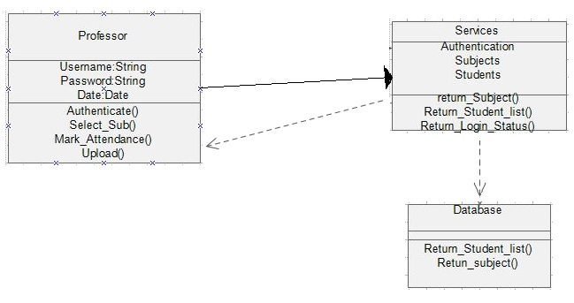
Contd..
2.2 Class Diagram:

Slide 9
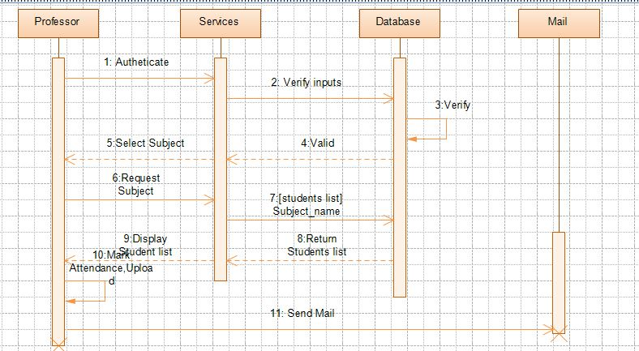
Contd..
2.3 Sequence Diagram :

